Slide 1

Credit card approval PREDICTION
BINARY CLASSIFICATION
Machine learning portfolio
DEREK RODRIGO SÁNCHEZ SEGUAME

Slide 2
Task Definition
EDA
Model and Results

Slide 3
01
Task Definition

Slide 4
Task Definition
Problem statement | MEDICAL PREMIUM CHARGE
SaludVital Analytics is the advanced-analytics division of a leading Mexican health insurer that underwrites policies for individuals and families across middle- and upper-income segments. Leveraging an extensive distribution network and product portfolio, the insurer has achieved strong premium growth but now faces claim costs that are rising faster than actuarial forecasts.
To address this, SaludVital will implement a machine-learning–powered predictive engine using the Medical Charges dataset, which includes age, sex, region, BMI, smoking status, number of dependents and actual annual medical charges. By applying sophisticated regression models and robust feature selection, the project will refine premium pricing to align rates with predicted claim costs. It will also optimize reserve adequacy and regulatory capital planning through more precise loss forecasts. Additionally, the engine will identify high-cost segments for targeted wellness programs and personalized member engagement—enhancing underwriting profitability and strengthening the insurer’s competitive positioning in Mexico’s health-insurance market.
4

Slide 5
WIP
Task Definition
Medicine and data | medical management powered by predictive models
Business Context
As
Asdgas
Gasgas
Asgad
Asdgasd
Asdgasd
Asdgas

Slide 6



WIP
Task Definition
BANKING AND DATA | USING MACHINE LEARNING TO FIND THE OPTIMAL RISK PROFILES
CardSecure is a mexican retail banking division
Their target market are young professionals and SMEs
They’ve exceeded their origination goals in the first two years
Our client
they are experiencing excessive defaults in credit card origination due to unsound risk model
This generates problems in:
Income (NII)
Higher Loss Provisions (PCLs)
Strategic Approach
Pain point
Using the provided dataset, a Machine Learning Binary Classification Model will be generated
This model will evaluate each client to decide if they are fit to approval or rejection of a credit card
Solution
6
Note:

Slide 7
02
Exploratory Data Analysis

Slide 8
Overview | an unbalanced target variable
EXPLORATORY DATA ANALYSIS
WIP
# of Features | By data type
# of Categorical Features | By # of unique observations
 | #Features
Numerical | 11
Categorical | 8
Total | 19
 | Two Unique Obs | Three to five Unique Obs | Five+ Unique Obs
#Features | 3 | 3 | 2
Categorical Features Distributions
Target
Features
Churn
Gender
House Owner
Education
Occupation
Note:
8

Slide 9
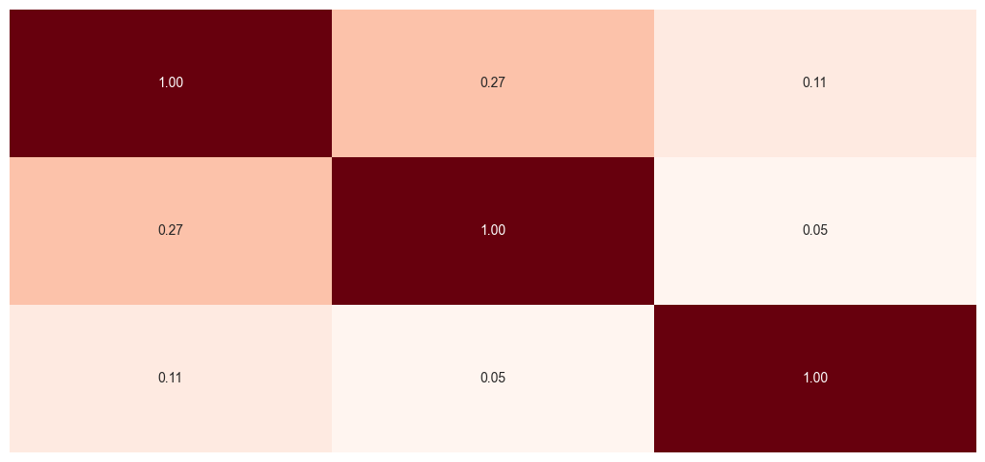
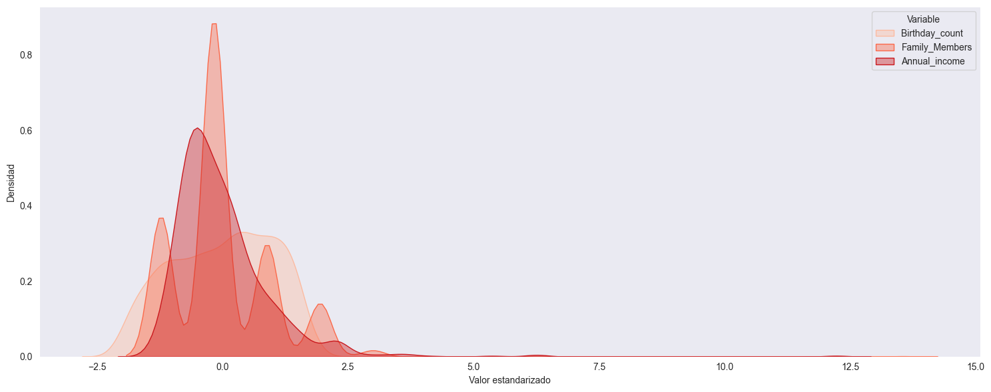
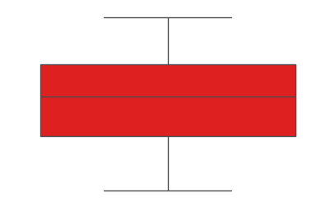
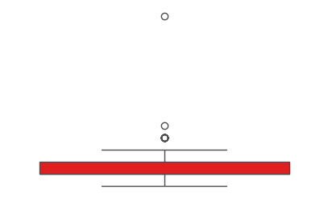
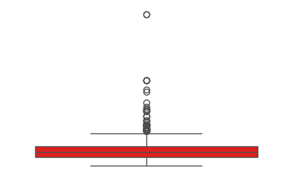
Numerical variables | heatmap, distributions and boxplots
EXPLORATORY DATA ANALYSIS
WIP
Correlation Matrix Heatmap
Distribution Graph
Age
Family members
Income
Age
Family members
Income
Box plot | by feature
Age
Family Members
Annual Income
9

Slide 10
03
Model Selection and Results

Slide 11




Model selection and results
WIP
Model selection | Gradient boosting performed the best in f1 score; optimal for unbalanced datasets
Model
Tuning
Parameters
Metrics
Gradient Boosting
Randomized Search
learning rate = 0.01
n_estimators = 100
Max_Depth = 4
F1: 98%
Precision: 97%
AUC ROC: 99%
Random Forest
Randomized Search
n_estimators = 427
max_depth = 17
F1: 98%
Precision: 97%
AUC ROC: 99%
Logistic Regression
Grid Search
L1 Regularization
C = 5.2
F1: 97%
Precision: 97%
AUC ROC: 99%
SVM
Grid Search
C = 1.0
kernel = rbf
F1: 49%
Precision: 92%
AUC ROC: 98%
Note:
11

Slide 12



Results
WIP
FROM DATA TO ACTION ITEMS | BUSINESS VALUE PROVIDED BY MACHINE LEARNING
Findings
Conclusions
Next Steps
Gradient Boosting has the best scoring overall
In unbalanced datasets traditional scoring metrics (accuracy) won’t reflect real performance for the model
In general, the drivers of approval are
Occupation
Age
Income
A solid classification model will improve approval criteria and allow the operation to escalate
Deploy and monitor the model for unaccounted scenarios
Keep track of KPIs such as
Past due credit card volume
PCL ratio
Note:
12

Slide 13
Task Definition
WIP
Communications AND Customer churn | Risk management powered by machine learning
Our client
Pain point
Solution
TeleConnecta is a mexican Fintech
Their target market are SMEs
They’ve had an expansive strategy to achieve market share goals
they are experiencing excessive defaults due to:
Its broad market reach
Unsound retention strategy
This generates problems in:
Profitability
Competitveness
Using the provided dataset, a Machine Learning Binary Classification Model will be generated
This model will evaluate each client and estimate the churn possibility
Note:
13

Slide 14
Model selection and results
WIP
Model selection | Gradient boosting a logistic regression performed roughly the same but better than k-nn
Model
Tuning
Parameters
Metrics
K-NN
Randomized Grid Search
11 nearest neighbors
Accuracy: 60%
Precision: 61%
AUC ROC: 63%
Logistic Regression
Randomized Grid Search
L1 regularization
C = 0.1
Accuracy: 64%
Precision: 65%
AUC ROC: 68%
Gradient Boosting
Randomized Grid Search
Leafs = 2
Max Depth = 3
Learning rate = 0.1
Accuracy: 64%
Precision: 69%
AUC ROC: 68%
Note:
14

Slide 15
Model selection and results
WIP
FROM DATA TO ACTIONABLES | the power of data to provide business solutions
Gradient Boosting has the best precision, but…
Findings
Simplier models like Logistc Regression adhere more to regulation and have easier interpretations
Considering the client’s concern of regularatory standards, Logistic Regression might be suitable
Conclusions
Next steps
Final Thoughts
Newly acquired customers have the highest possibility of churn
It is important to have a reliable risk model
Despite several tests and treatment, dataset might be noisy and affect predictive power
Improving model performance
Discovery process with the client to ask for a dataset with:
More observations
More features
15

Slide 16
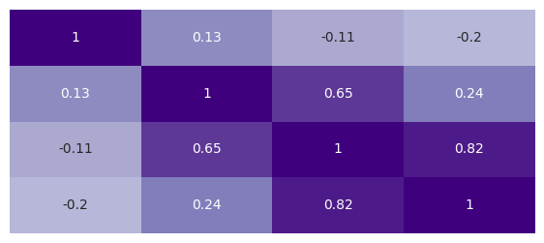
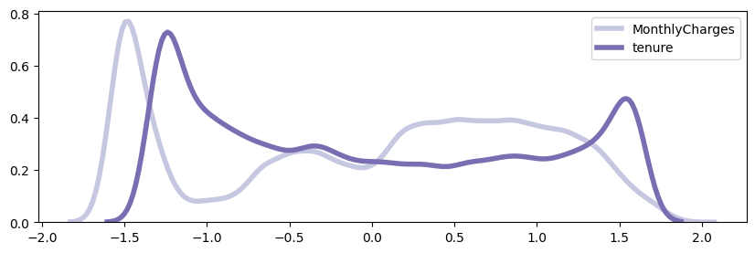
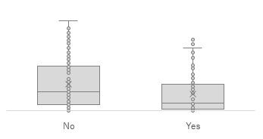
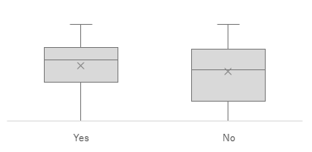
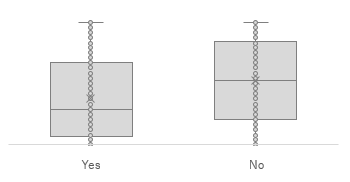
Numerical variables | heatmap, distributions and boxplots
EXPLORATORY DATA ANALYSIS
WIP
Correlation Matrix Heatmap
Distribution Graph
Churn
Monthly
Total Charge
Tenure
Churn
Monthly
Total Charge
Tenure
Box plot | by feature
Tenure
Monthly
Total Charge
Churn
16

